Slide 1

JSX Deep Dive

Slide 2
Behind React.createElement
Every JSX element gets transpiled during build into React.createElement
The function accepts 3 properties:
Type
Either an existing HTML element or a custom type you created
Props
The element properties
Children (optional)
One or more children
Can be string (the element's content) or other elements
Notes:
There’s more to a React Component, but will get to that in a bit

Slide 3
Behind React.createElement
<div
className="header“
exampleProp="{'example’}”
>
Header Title
</div>
React.createElement(
"div", {
className: "header",
exampleProp: "{'example’}”
},
"Header Title“
);
* Notice that default HTML elements are passed in as strings
Notes:
There’s more to a React Component, but will get to that in a bit

Slide 4
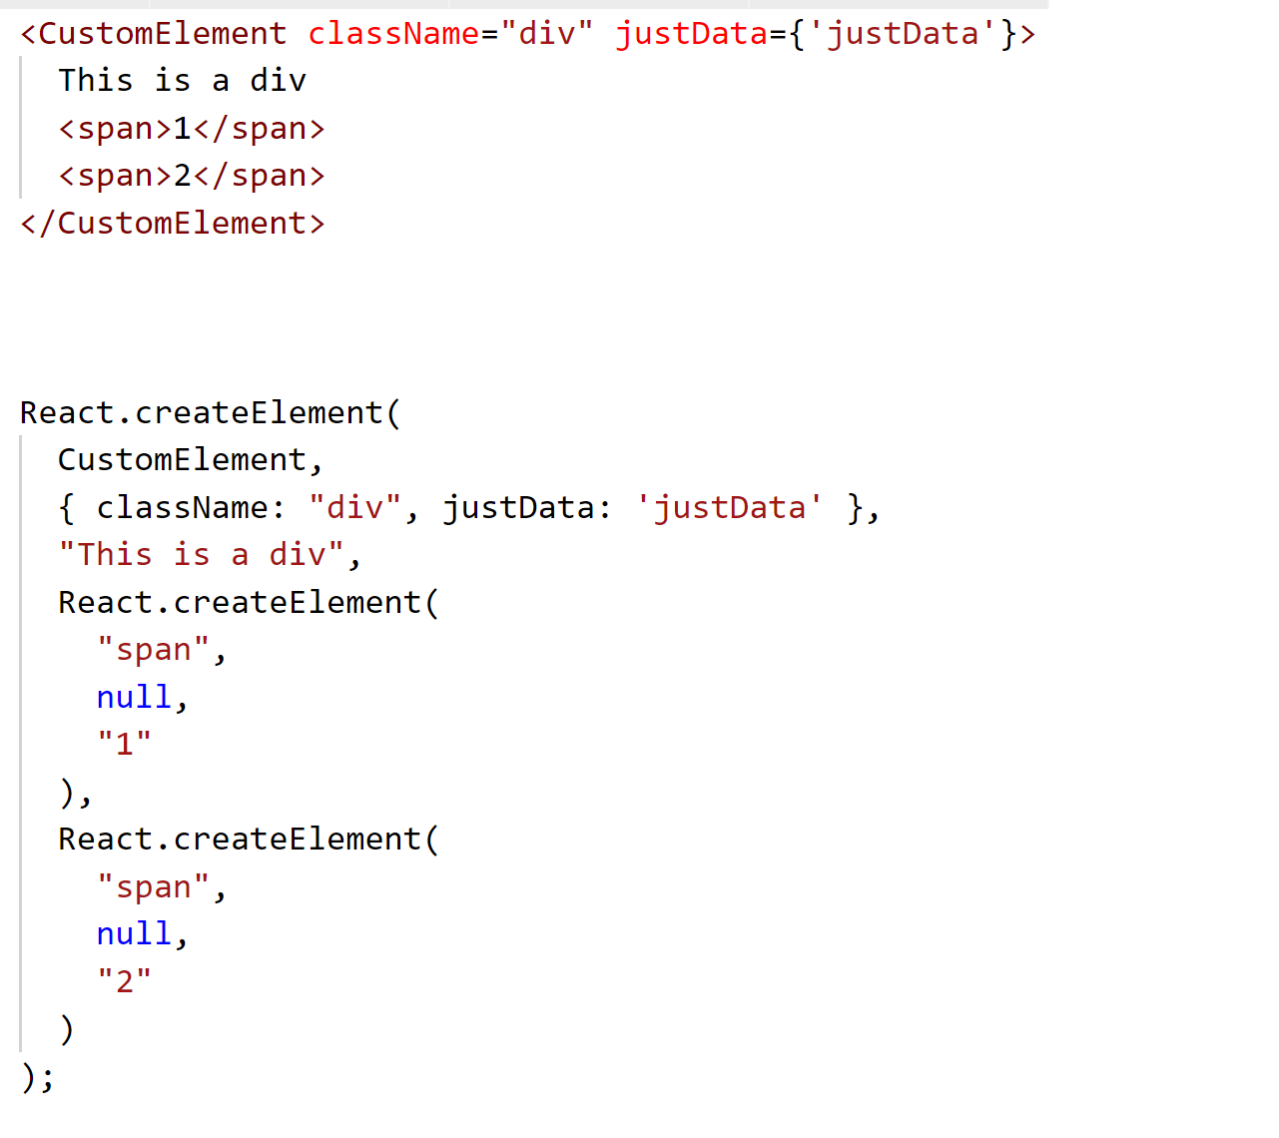
Behind React.createElement

Slide 5
Playing with JSX Online
https://goo.gl/diBrz1
Online babel compiler with JSX support
Shows you the transpiled JSX instantly
Notes:
There’s more to a React Component, but will get to that in a bit

Slide 6
Writing React Without JSX
Yes, that happens
Then, it’s a plain JavaScript class
No transformation necessary
Useful for dynamic element support
E.g. HeadingComponent (h1/h2/h3)

Slide 7
JSX Dynamic Element
export default ({ size, children, className, ...props }) =>
React.createElement(
`h${size}`,{
className: classNames([
className, `heading heading-${size}`
]), ...props
} , children
)

Slide 8
Writing React Without JSX
var R = React.createElement;
return (
R(CustomElement, { className: “div”, justDate: “justData” },
“This is a div”, R(“span”, null, “1”), R(“span”, null, “2”)
);
)

Slide 9
Specialized Identifiers
JSX is an extension of JavaScript
Identifiers that correspond to JavaScript keywords are discouraged
It is recommended to use the DOM property name identifiers instead
For example
class → className
for → htmlFor
<h1 className="App-title"> Welcome to React </h1>

Slide 10
Ternary Operator And JSX
A shorthand to expression-based if-else statement
Not unique to JSX but helpful when trying to add logic to Render
condition ? expr1 : expr2
{this.state.var ? <div className='warning'>{this.state.var}</div> : ''}

Slide 11
Conditional Rendering
Boolean, null and undefined are ignored at rendering
Can use short-circuit conditional to render something or not
{this.props.showHeader && <Header />}
Notes:
Boolean, null, undefined

Slide 12
JSX Expressions
JSX supports full JavaScript expressions as props
Can use '{}' and expression as inline content
Can render items off array via 'map' operator
<MyComponent foo={1 + 2 + 3 + 4} />
function Hello(props) {
return <div>Hello {props.name}!</div>;
}
function TodoList() {
const todos = ['finish doc', 'submit pr'];
return (
<ul> {todos.map((p) => <Item message={p} />)} </ul>
);
}

Slide 13
Render – Multiple Root Elements
Render is supposed to return a single root element
How about rendering multiple items?
Can combine under a root element, e.g. div
Affects the DOM
Alternatively
Return array – requires keys to suppress warnings
React fragments – a parent that doesn't affect the DOM
supports a shorthand, can experience a build error in an unsupported babel version
render() {
return [
<h1 key='1'>Child 1</h1>,
<p key='2'>Child 2</p>
];
}
render() {
return (
<React.Fragment>
<h1 key='1'>Child 1</h1>,
<p key='2'>Child 2</p>
</React.Fragment>
);
}
render() {
return (
<>
<h1 key='1'>Child 1</h1>,
<p key='2'>Child 2</p>
</>
);
}

Slide 14
Assigning JSX
While JSX is mostly used in render, it can also be refactored to multiple functions and assigned to variables
Improves readability and maintainability
const header = renderHeader();
const button = <input type=“button” value=“click me” />

Slide 15
Passing objects as props
JSX supports the spread operator
Enables passing objects as key/value props
const obj = {id: 1, name: “guy”, age: 36}
return ( <Person {…obj} />
);

Slide 16
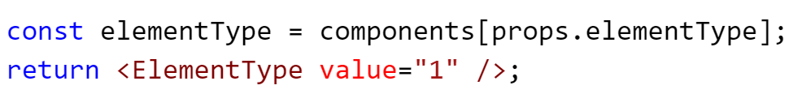
JSX Tips and Tricks
JSX components can be called using the dot notation
While object keys or maps are unsupported as React element nodes (<component[props.type] />) there’s an easy workaround
Notes:
There’s more to a React Component, but will get to that in a bit

Slide 17

Exercise – React Portfolio
Notes:
There’s more to a React Component, but will get to that in a bit

Slide 18
Exercise – React Portfolio
Create a simple Portfolio application – use the design provided in the previous slide
The application has three views:
Portfolio view – a grid of portfolio items, each containing a small image, a title, a delete icon and an edit button (deleting a portfolio item removes it from the list, editing a portfolio item takes you to the edit view)
Add / Edit portfolio item – a form that contains a title, description and image url. Use controlled components. Title and image url are required.
About page – a page with some text and images (about you?)
Notes:
There’s more to a React Component, but will get to that in a bit

Slide 19
Exercise – React Portfolio
Using the left menu a user can navigate between the views (changes the view in the centre pane)
In addition, clicking a portfolio item will switch the center pane to a full view of the portfolio item which can be closed (a forth view)
Populate a list of portfolio items using a static JSON object
Clicking the social links should open a new tab with the relevant link
Verify props types of all components using PropTypes (Added after Module 5)
Notes:
There’s more to a React Component, but will get to that in a bit

Slide 20
Exercise – React Portfolio
Use css to align the design of the application to the design provided (if you have time add css animations when changing views)
Notes:
There’s more to a React Component, but will get to that in a bit

